Slide 1

Robust Estimation for Markowitz
Quantitative Trading with R
Prof: Patrick Kerl
Group: Ridhima Lawane - 1779783
Abhiruchi Bharambe - 1783040
Shubham Darekar - 1783774
Quantitative Trading with R
1/16

Slide 2
“How should an investor split €100,000 across 10 stocks optimally?"
Key Challenge:
- Too many possible combinations
- Need a mathematical approach
- Must balance return vs risk
Quantitative Trading with R
2/16
Notes:
We learnt basic mvo is the foundation of basic optimization
In case of basic mvo, it assumes your estimates of mu (expected returns) and sigma(cov and risk) are perfectly correct but in reality stock return estimates from historical data are never perfect
So a ques arises ; what can we do to make basic Markowitz work better in the real world
The solution is a robust MVO where instead of trusting the estimates blindly we say that my return estimate may be wrong by some amount rho and whats the worst case scenario; lets optimize that
Moving on to the prob we would be solving
Imagine you have 100,000 and you want to invest it wisely. Now the ques is which stocks should i buy
A bad advisor good advisor will say its not about which stocks, its about the percentage of each stock and that is a mathematical prob. Which is our proj
Now why is this hard.
Too many combos- we have lets say 10 stocks and 100,000 to split we can put 10 % in each stock equal split or 50-50 in 2 stocks or any combo in other stocks
Infinite combo possible so we need to use mathematical approach – specifically convex optimization using cvxr in r- tries all combo and finds the best one in a frac of sec
Need math framework
Before Markowitz published his paper, investors had no mathematical approach at all . there was no consistency; two investors can look at same stocks and make completely diff decisions. no way to tell which is better
Markowitz changed everything by saying we have an objective-max reurn and have constraints- limit risk we solve it mathematically
This Gave investors consistent , reliable, and optimal approach
Balance return and risk
A company can give you more return and less risk or viceversa ;which would u choose. Markowitz suggetdw e combine both, dont choose one. By combining stock that dont move together, called low correlation we reduce overall risk without sacrificing return

Slide 3
What is MVO?
Mean- Variance Optimization (MVO)
Two things every investor wants:
HIGH Return (μ) — make money
LOW Risk (σ²) — stay safe
Mathematical Formulae:
Portfolio Return = wᵀμ
Portfolio Risk = wᵀΣw
Sharpe = Return/ Risk
Goal of MVO:
Maximize return for given risk level
Or
Minimize risk for given return target
Quantitative Trading with R
3/16
Notes:
Mvo is mean variance otpimization introduced by Harry Markowitz in 1952ie basically a recipe for building the best proftfolio, it gives u the most return for the risk u are willing to take
Core idea, every investment has 2 things return-how mnuch money it makes on avg and risk-how much that return bounces around(volatility)
The math formula used are-
Return-Weighted avg of each assets exp return w is how much weight u put, mu is expected rrutn
Risk- weighted risk, accounting for how assets move together sigma is cov mat tells how volatile each asset is
Sharpe return per uunit risk

Slide 4
Data Set:
From sectors like Technology,Finance, Healthcare,Energy,Consumer
2019-2024
Quantmod package in R
Quantitative Trading with R
4/16
Notes:
How robust MVO is it related to finance?

Slide 5
Our three Portfolios:
Basic Markowitz
Unconstrained MVO
Shows problem
Add Constraints
No short Selling!
Max 20% per stock
Improved results
Add Robustness
Handle estimation errors
Worst-case optimization
Gives best Result
Quantitative Trading with R
5/16
Notes:
Basic mvo- produces unrealistic portfolios. So we need constraints to fix it
Const-
Two rules like
no short selling- u cant bet against a stock, u only own it
max 20 perct per stock- to prevent over-concentration
we get a diversified and sensible portfolio but assumes data is perfect
robusteness- but there still a weakness the optimizer still treats estimated return and cov as acc but they are not
hence we come to robustness-
we do worst case optimization where it looks at a range of values for return per risk and picks the protfolio that perfoms reasonable well across that range
gives best res because it doesn’t fall apart when reality doesn’t match the estimates its rather stable and realistic and resilient to the fact that your data is imperfect

Slide 6
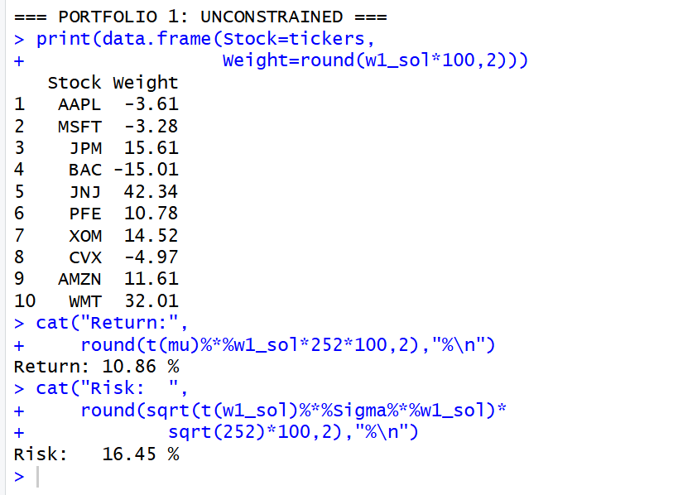
Portfolio 1: Unconstrained MVO
Problem: Minimize Risk
sum(w) = 1 only
Results:
AAPL = -3.61% ← SHORT SELLING
BAC = -15.01% ← SHORT SELLING
JNJ = 42.34% ← TOO CONCENTRATED
Return = 10.86%
Risk = 16.45%
Sharpe = 0.660
Result: Problematic!
Quantitative Trading with R
6/16
Notes:
Short selling?

Slide 7
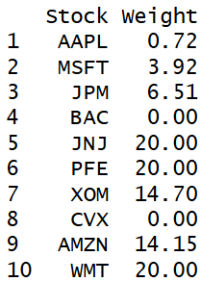
Portfolio 2: Constrained MVO
w ≥ 0 (no short selling)
w ≤ 0.20 (max 20% per stock)
Results:
Return = 12.99 %
Risk = 17.78 %
Sharpe = 0.731
Result: Realistic and Usable
Quantitative Trading with R
7/16

Slide 8
Problem with Estimation of Portfolio 1 & 2:
Both the portfolios estimate results based on past data
Solution:
Robust optimization
Optimize for worst case
Quantitative Trading with R
8/16

Slide 9
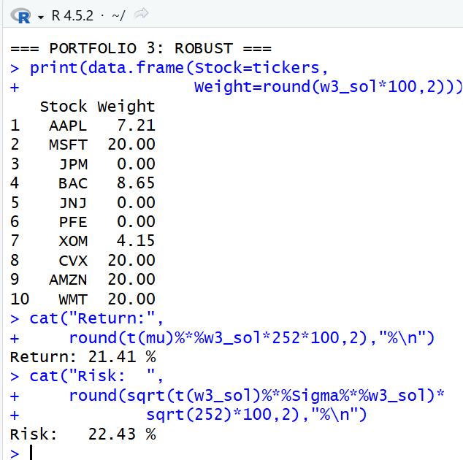
Portfolio 3: Robust MVO
Boyd et al.’s key idea (2024):
‘What if our estimates are wrong?’
Two Uncertainty Parameters:
ρ = return uncertainty
"I might be off by this much"
ϱ = covariance uncertainty
"Risk might be higher than estimated"
Worst-Case Return:
R_wc = μᵀw (expected uncertainty) - ρᵀ|w| (return penalty)
Result: best performing
Return = 21.41%
Risk = 22.43%
Sharpe = 0.955
Quantitative Trading with R
9/16

Slide 10
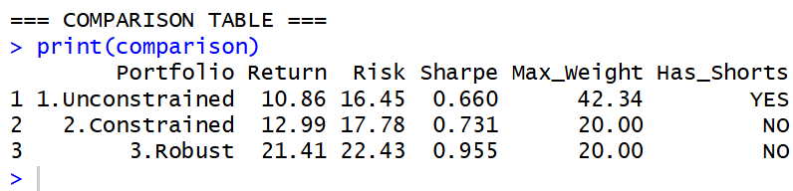
Comparison table for all the 3 portfolios results:
Result: Sharpe improves from 0.660 -> 0.731 -> 0.955
Quantitative Trading with R
10/16

Slide 11
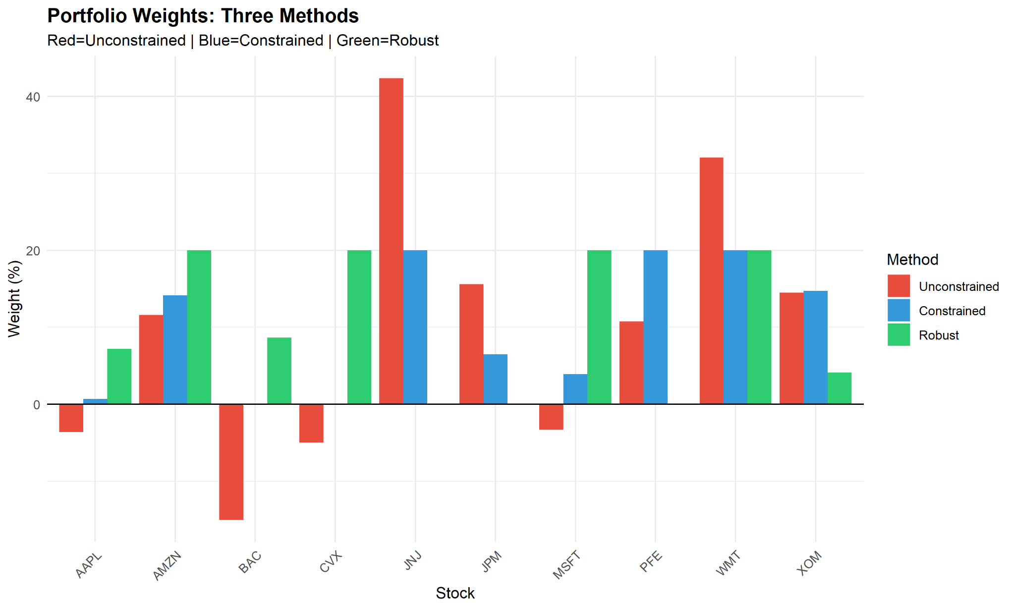
Portfolio Weight Comparison:
Quantitative Trading with R
11/16
Notes:
This graph compares how much money is invested in each stock.
Each group of three bars represents one stock, and each color represents one of the three portfolios.
Portfolio 1 (Unconstrained MVO)
Some bars go below zero, which means negative weights.
Negative weights indicate short selling.
Some stocks have very large positive weights, showing the portfolio is concentrated in only a few stocks.
This makes the portfolio unrealistic.
Portfolio 2 (Constrained MVO)
All bars are above zero because short selling is not allowed.
No stock has more than 20% weight.
The investments are more evenly distributed.
This makes the portfolio practical and diversified.
Portfolio 3 (Robust MVO)
The weights are also positive, but they are adjusted to account for uncertainty.
The investments are spread more carefully among the stocks.
This creates a portfolio that is more stable and performs better when market estimates are wrong.

Slide 12
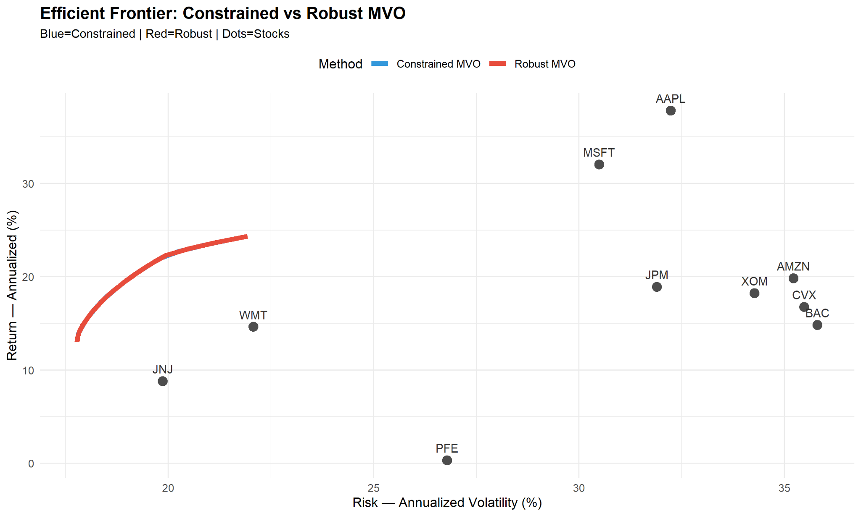
Efficient Frontier:
Quantitative Trading with R
12/16
Notes:
"This graph is called the Efficient Frontier. It shows the relationship between risk and return for different portfolios.“
"This graph compares the Efficient Frontier of the Constrained MVO and Robust MVO models. The black dots represent the individual stocks. The x-axis shows risk, and the y-axis shows return. The red curve represents the Robust MVO Efficient Frontier. Although it shows a blue line for the Constrained MVO, it is not visible because it overlaps almost completely with the red curve. This indicates that both models produce very similar efficient frontiers, but the Robust MVO is preferred because it accounts for uncertainty in returns and risk.“
Q1. What is the Efficient Frontier?
Answer: It is a curve showing the best portfolios that provide the highest return for each level of risk.
"The constrained and robust efficient frontiers are very close to each other. The robust curve is plotted on top of the constrained curve, so the blue line is hidden."

Slide 13
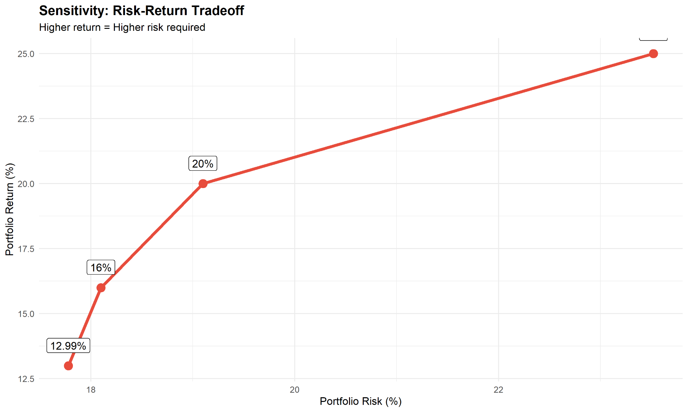
Sensitivity Analysis — Risk-Return Tradeoff
Quantitative Trading with R
13/16
Notes:
relationship between portfolio risk and portfolio return.
Sensitivity Analysis because it helps us understand how the portfolio's return changes when we accept different levels of risk.
X-axis (Horizontal): Portfolio Risk (%)
It represents the amount of risk in the portfolio.
As we move to the right, the risk increases.
Y-axis (Vertical): Portfolio Return (%)
It represents the expected return from the portfolio.
As we move upward, the return increases.
The line moves upward from left to right.
This shows a positive relationship between risk and return.“
Low Risk → Lower Return
High Risk → Higher Return
: if an investor wants a higher return, they must be willing to take a higher level of risk. Investors can choose the point on the graph based on their own risk tolerance."

Slide 14
Conclusion:
Basic MVO -> unrealistic , short selling, extra weights
Constrained MVo -> realistic and better performance
Robust MVO -> risk adjusted return
Quantitative Trading with R
14/16
Notes:
focuses only on maximizing return and minimizing risk.
it has some practical problems.
allows short selling (negative weights) and
sometimes allocates too much money to a single stock.
not suitable for most real-world investors.“
2. "To overcome these problems, we added constraints such as no short selling and a maximum investment of 20% in any one stock.
This made the portfolio more balanced, diversified, and practical.
It also improved the Sharpe Ratio from 0.660 to 0.731.“
3. model considers uncertainty in return and risk estimates.
Instead of assuming that past data is always correct, it prepares for worst-case situations.
produced the highest Sharpe Ratio of 0.955, making it the best-performing portfolio among the three.“
From our analysis, we conclude that Robust MVO is the best approach because it
provides better risk-adjusted returns,
handles uncertainty effectively, and
creates a more reliable portfolio for real-world investment decisions.“
"In this project, we compared three portfolio optimization methods.
The Basic MVO was unrealistic because it allowed short selling and concentrated investments.
The Constrained MVO made the portfolio more practical by limiting stock weights and improving diversification.
The Robust MVO further improved the model by considering uncertainty in returns and risk.
It achieved the highest Sharpe Ratio of 0.955, showing the best balance between risk and return.
Therefore, we conclude that Robust MVO is the most effective and practical portfolio optimization method.

Slide 15
References: -
Markowitz (1952) — Portfolio Selection
Boyd et al. (2024) – Markowitz at Seventy
Quantitative Trading with R
15/16

Slide 16
Thank you
Quantitative Trading with R
16/16

